Slide 1
Project Proposal Presentation: Clsassification of aircraft in satellite images using deep learning methods.
Wojciech KARWOWSKI

Slide 2
Overview
The aim of the project is to develop and test a model that classifies different types of aircraft in aerial and satellite images.
The model is to enable automatic recognition of objects in conditions of variable background, different resolutions and image quality.

Slide 3
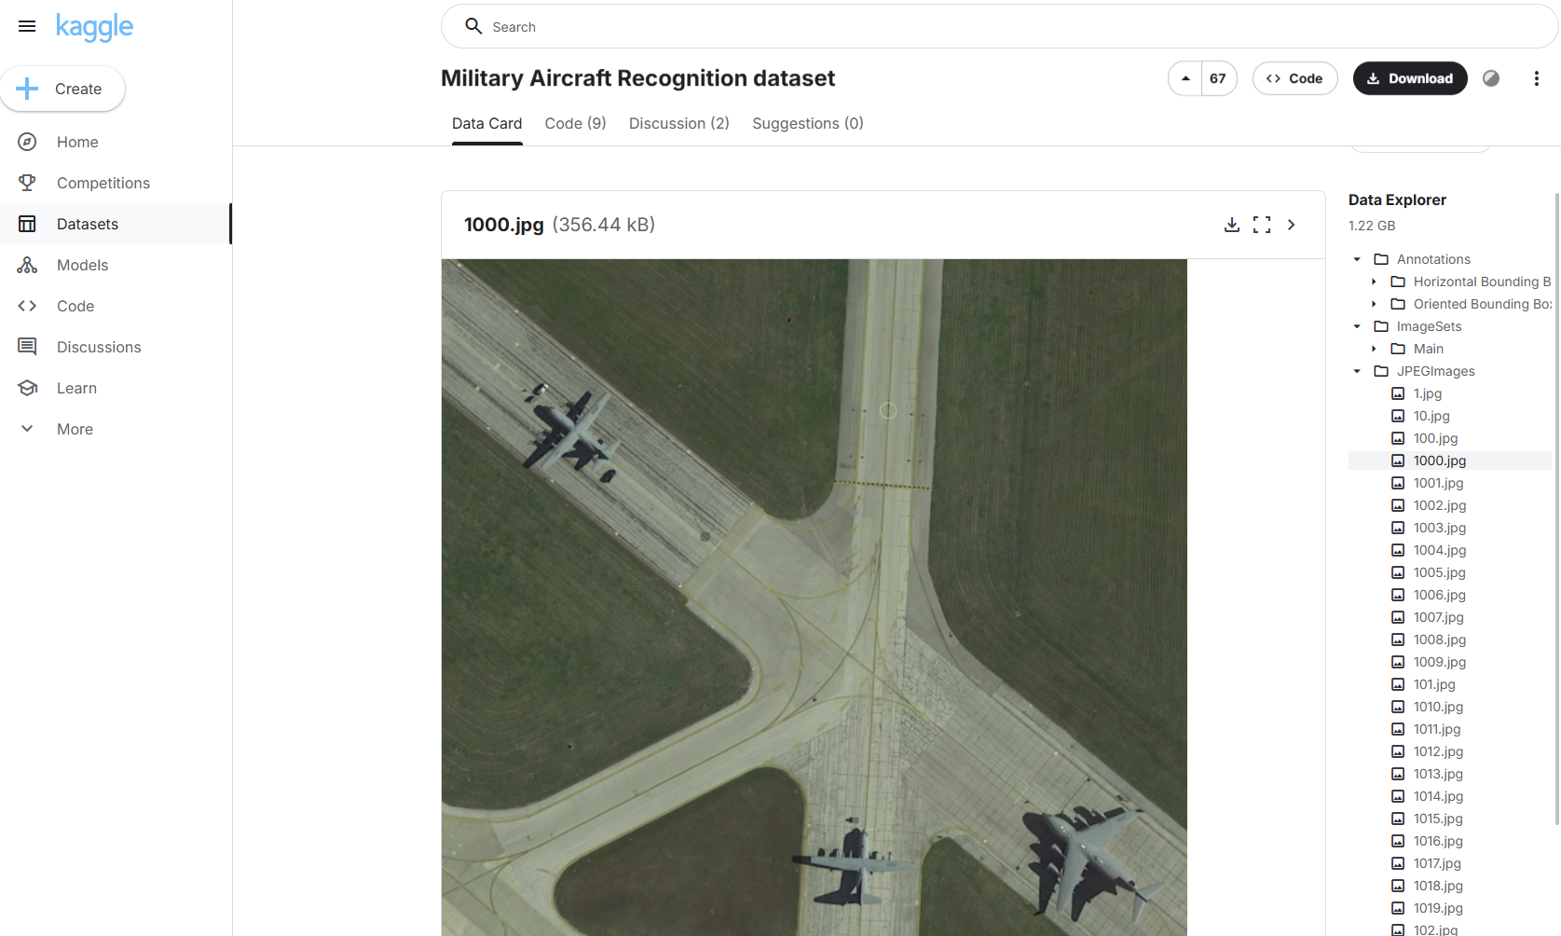
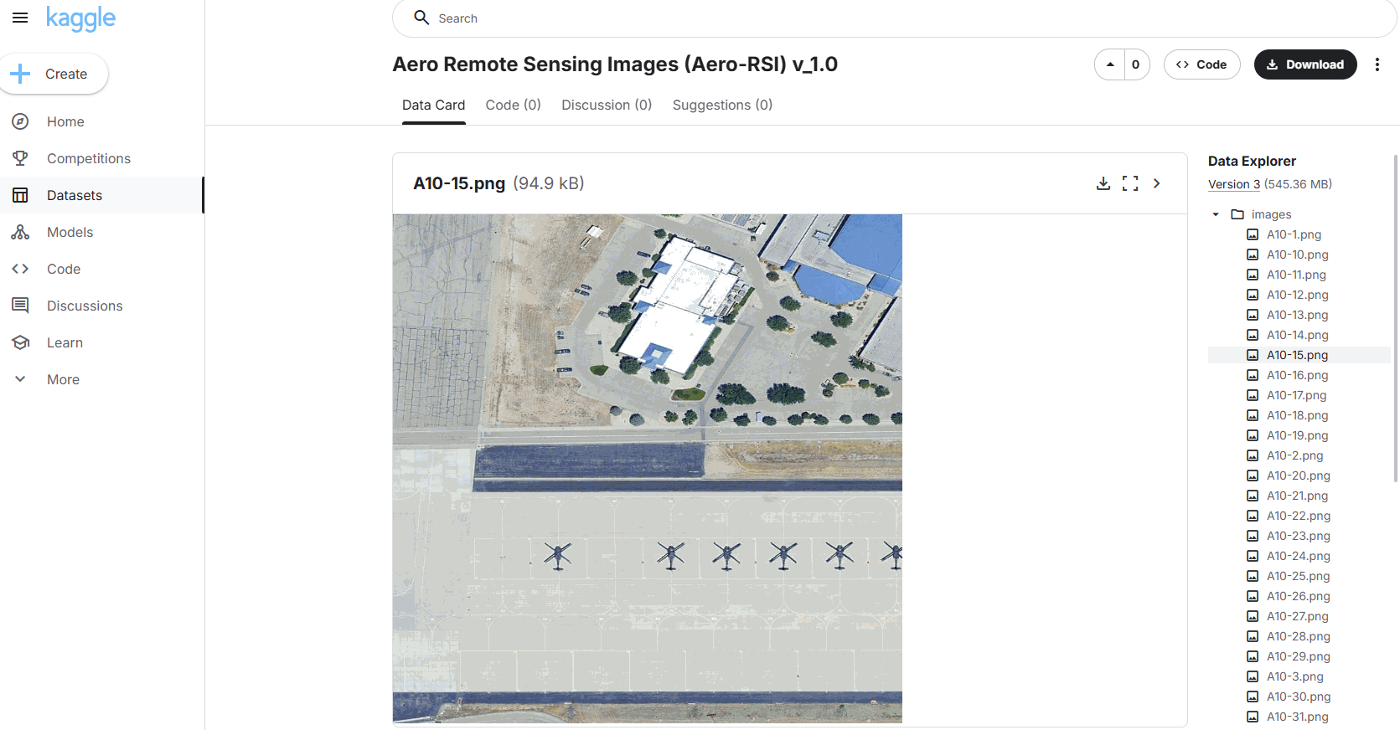
DATASET

Slide 4
Why not use a detector?
Detectors like YOLO require more training data
Higher computing requirements
Sensitive to changes in spatial resolution of images
Lack of user interaction

Slide 5
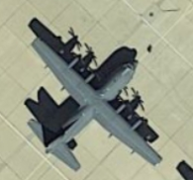
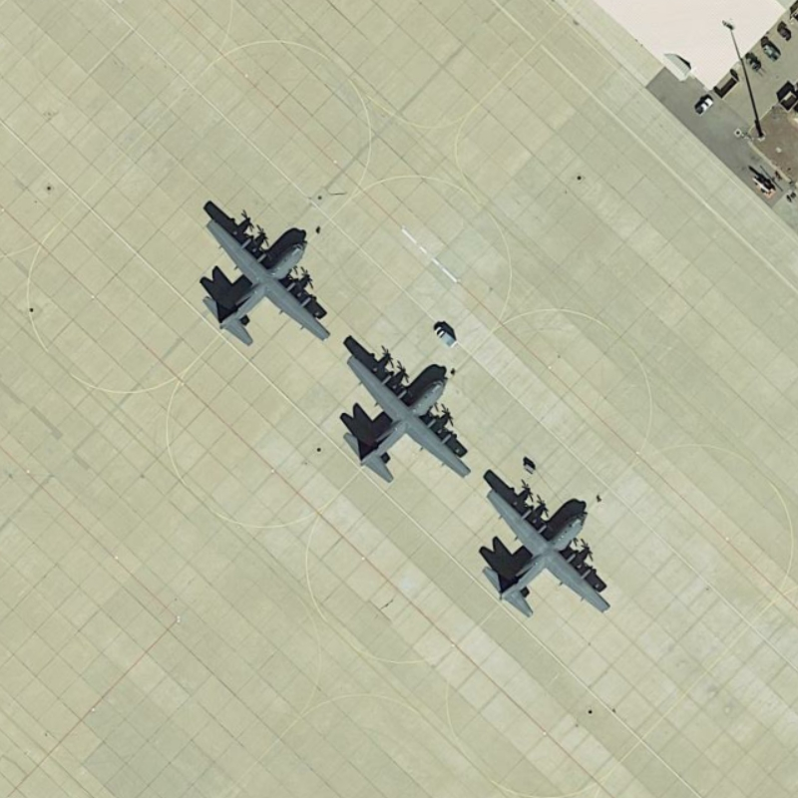

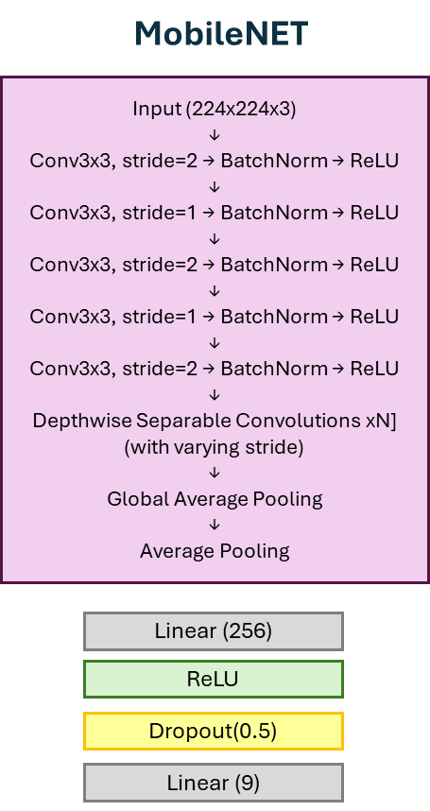



Proposed solution
Step 2: object indication
Step 3: image cutting
(bbox determined based
on image GSD)
Step 1: image loading
Hercules p. 0.89
Class 3: Hercules 89%

Slide 6
Project Plan
STAGE 1: DATA ACQUISITION
Downloading datasets
Selecting classes based on labels
STAGE 2: DATA PREPARATION
Cropping and normalizing images (considering the classifier model input size and labels)
Splitting data into classes (based on labels)
Data augmentation

Slide 7
Project Plan
SATGE 3: MODEL TRAINING
Selection of classifier models (https://docs.pytorch.org/vision/main/models.html)
Model training (using transfer learning)
Evaluation of classification quality
Application of XAI tools to interpret model decisions

Slide 8
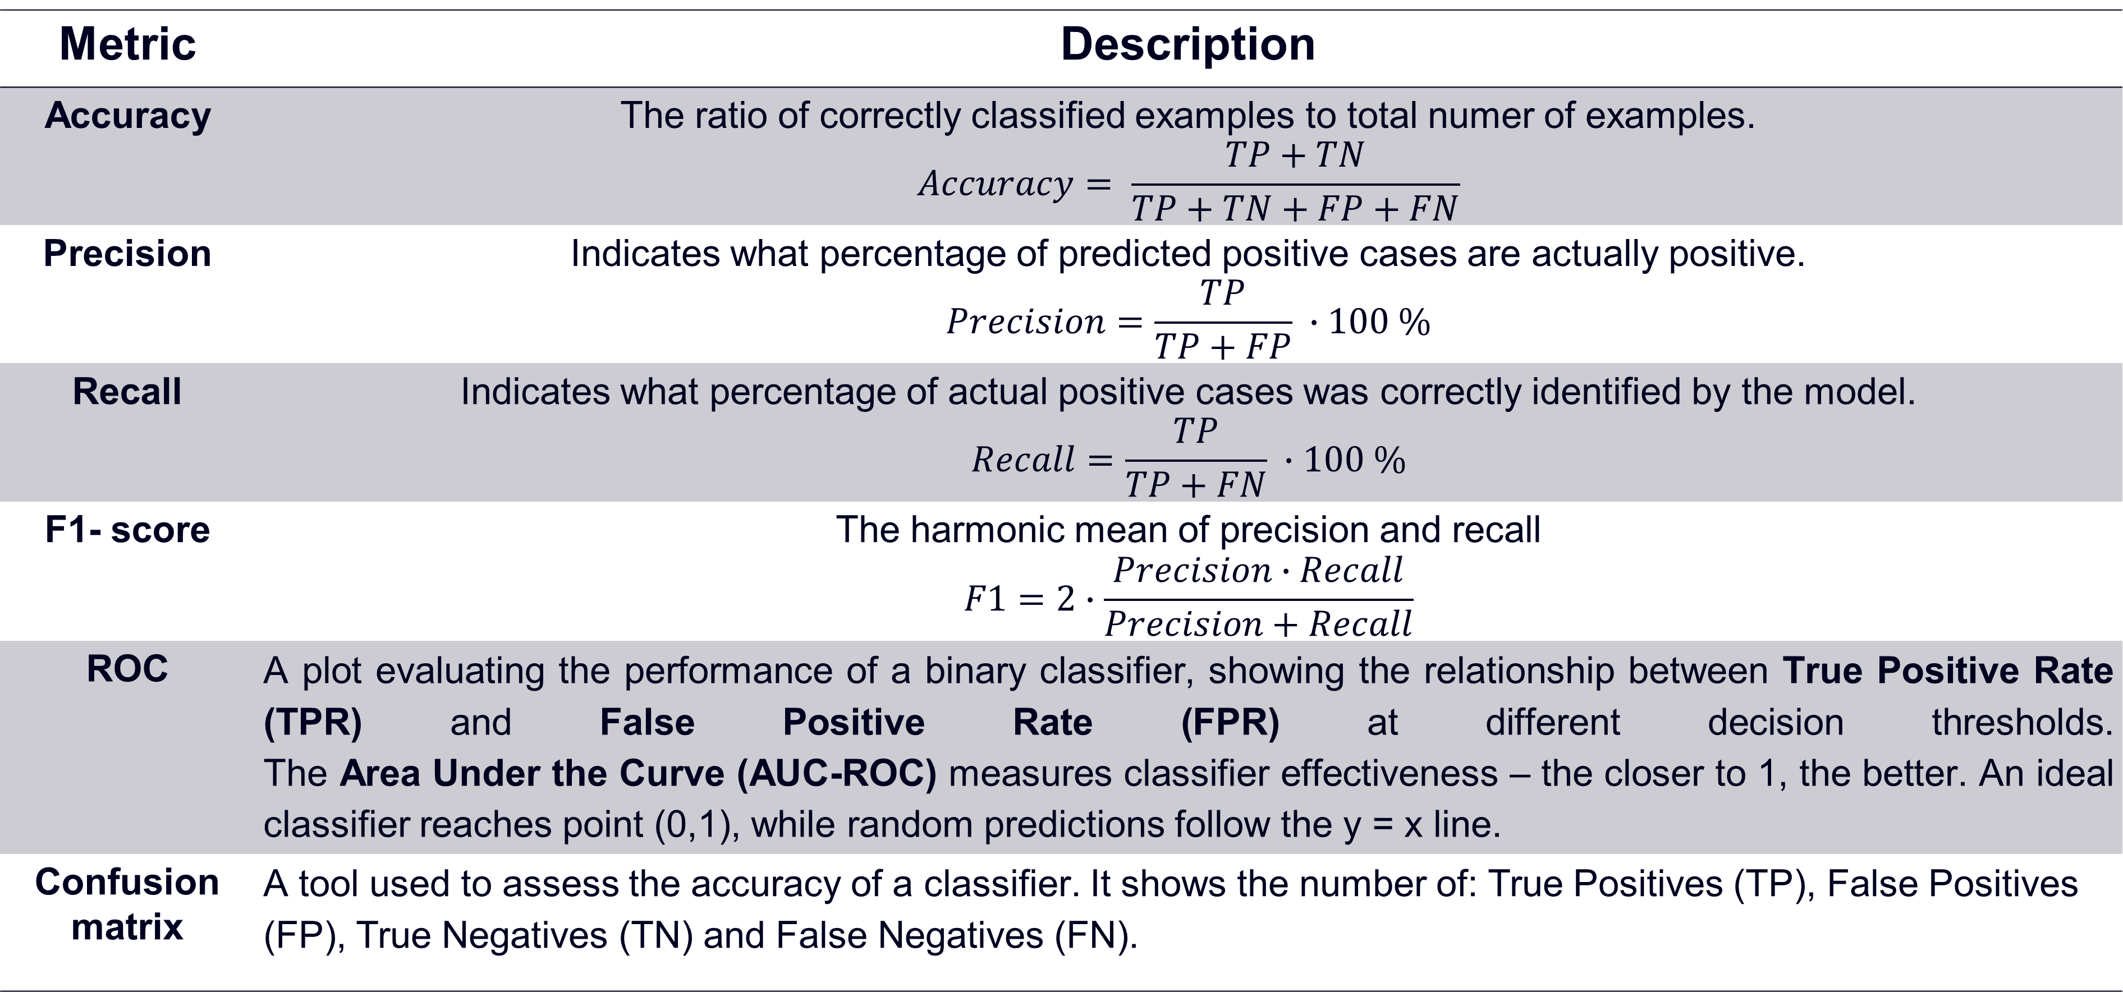
Evaluation of classification quality
Metric | Description
Accuracy | The ratio of correctly classified examples to total numer of examples. $$Accuracy= \frac{TP+TN}{TP+TN+FP+FN}$$
Precision | Indicates what percentage of predicted positive cases are actually positive. $$Precision=\frac{TP}{TP+FP} ∙100 \%$$
Recall | Indicates what percentage of actual positive cases was correctly identified by the model. $$Recall=\frac{TP}{TP+FN} ∙100 \%$$
F1- score | The harmonic mean of precision and recall $$F1=2∙\frac{Precision∙Recall}{Precision+Recall}$$
ROC | A plot evaluating the performance of a binary classifier, showing the relationship between True Positive Rate (TPR) and False Positive Rate (FPR) at different decision thresholds. The Area Under the Curve (AUC-ROC) measures classifier effectiveness – the closer to 1, the better. An ideal classifier reaches point (0,1), while random predictions follow the y = x line.
Confusion matrix | A tool used to assess the accuracy of a classifier. It shows the number of: True Positives (TP), False Positives (FP), True Negatives (TN) and False Negatives (FN).

Slide 9
XAI tools
LIME (Local Interpretable Model-Agnostic Explanations) - creates local, simplified models (e.g., linear models) to explain the predictions of a complex model in the neighborhood of a specific instance.
Saliency Map - highlights the pixels in an image that have the greatest influence on the model's prediction for a given class.
Grad-CAM (Gradient-weighted Class Activation Mapping) - uses activation maps from selected convolutional layers to visualize regions in the image that are important for the model’s classification decision.
Gradient SHAP - uses gradients and baselines to analyze the impact of features..
SHAP (SHapley Additive exPlanations) - An explanation method based on Shapley values from game theory. SHAP aims to understand the contribution of each feature to the model's prediction by assigning it a value that represents its individual impact on the output.

Slide 10
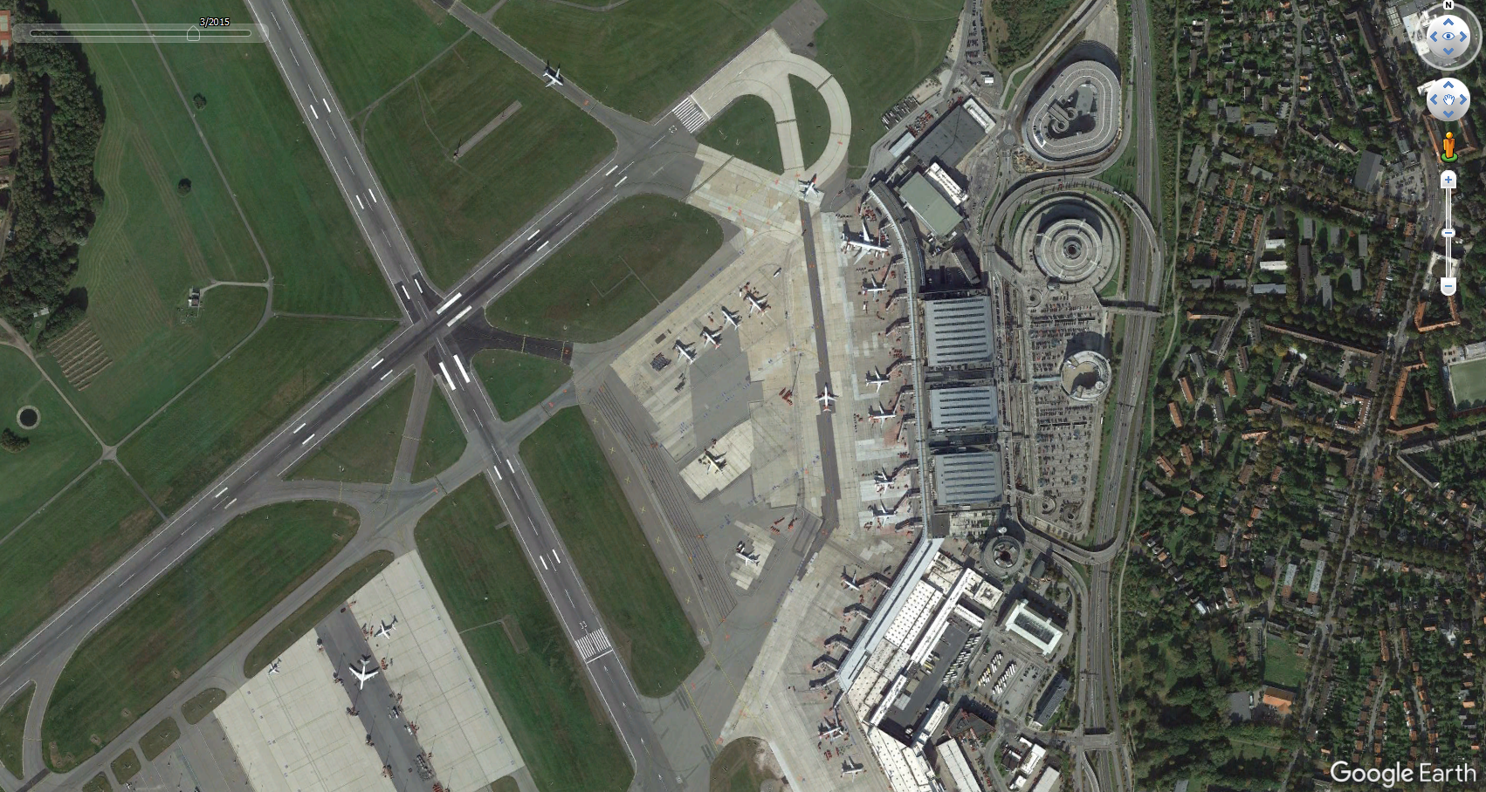
Project Plan
STAGE 4: MODEL TESTS
Model tests on independent data, e.g. satellite images, GoogleEarth

Slide 11
Risks
Insufficient data
Solution: data augmentation, transfer learning, expanding the dataset with images from Google Earth.
Model overfitting
Solution: data augmentation, dropout, increasing diversity of input data.

Slide 12
Legal-Ethical Issues
The project will be based on open-source datasets.
The project does not violate the privacy of individuals or private properties.

Slide 13
Example literature
Shaar, F.; Yılmaz, A.; Topcu, A.E.; Alzoubi, Y.I. Remote Sensing Image Segmentation for Aircraft Recognition Using U-Net as Deep Learning Architecture. Appl. Sci. 2024, 14, 2639. https://doi.org/10.3390/app14062639
Alganci, U.; Soydas, M.; Sertel, E. Comparative Research on Deep Learning Approaches for Airplane Detection from Very High-Resolution Satellite Images. Remote Sens. 2020, 12, 458. https://doi.org/10.3390/rs12030458
El Ghazouali, S.; Gucciardi, A.; Venturini, F.; Venturi, N.; Rueegsegger, M.; Michelucci, U. FlightScope: An Experimental Comparative Review of Aircraft Detection Algorithms in Satellite Imagery. Remote Sens. 2024, 16, 4715. https://doi.org/10.3390/rs16244715
Aydına, Halise Nur, Begüm Şenera, and Çağatay Berke Erdaşa. "Leveraging Deep Learning for Accurate Aircraft Classification in Remote Sensing Images."

